Slide 1

Topic: Evaluating Thermodynamic Properties
Lecture – 5
Disclaimer:
The study materials/presentations are solely meant for academic purposes and they can be reused, reproduced, modified, and distributed by others for academic purposes only with proper acknowledgements.

Slide 2
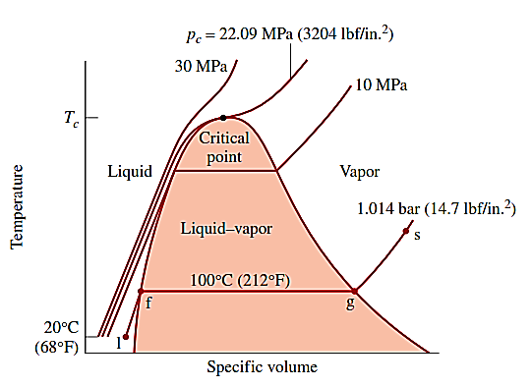
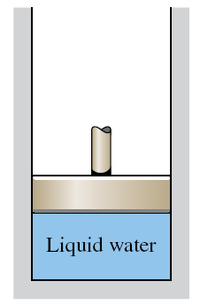
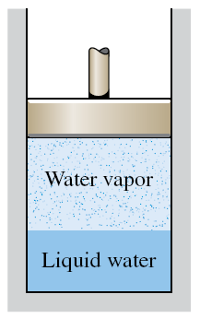
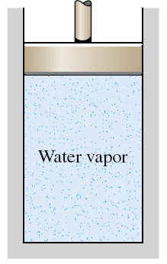
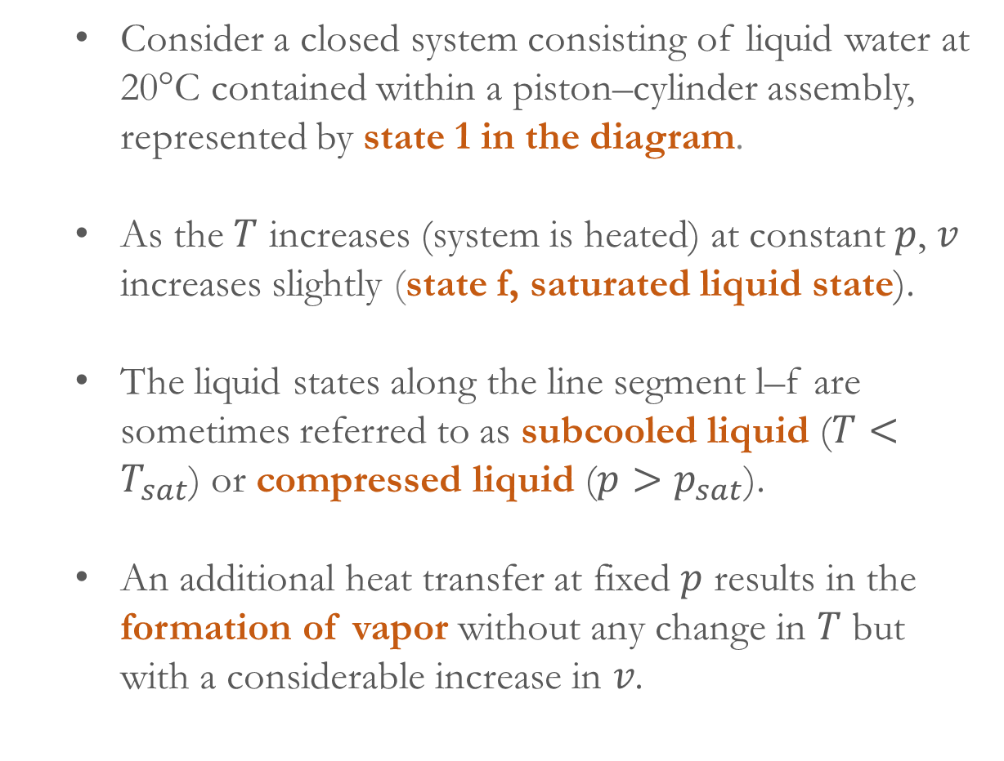
  Consider a closed system consisting of liquid water at 20°C contained within a piston–cylinder assembly, represented by state 1 in the diagram.
  As the $T$ increases (system is heated) at constant $p$, $v$ increases slightly (state f, saturated liquid state).
  The liquid states along the line segment l–f are sometimes referred to as subcooled liquid ($T<T_{sat}$) or compressed liquid ($p>p_{sat}$).
  An additional heat transfer at fixed 𝑝 results in the formation of vapor without any change in 𝑇 but with a considerable increase in 𝑣.

Slide 3
  When a mixture of liquid and vapor exists in equilibrium, the liquid phase is a saturated liquid and the vapor phase is a saturated vapor.
  On further heating, the last bit of liquid has vaporized (point g, saturated vapor state).
  The two-phase liquid–vapor mixture states can be distinguished from one another by the quality, an intensive property.
  The quality, 𝑥 is defined as a ratio of the mass of vapor present to the total mass of the mixture.

Slide 4
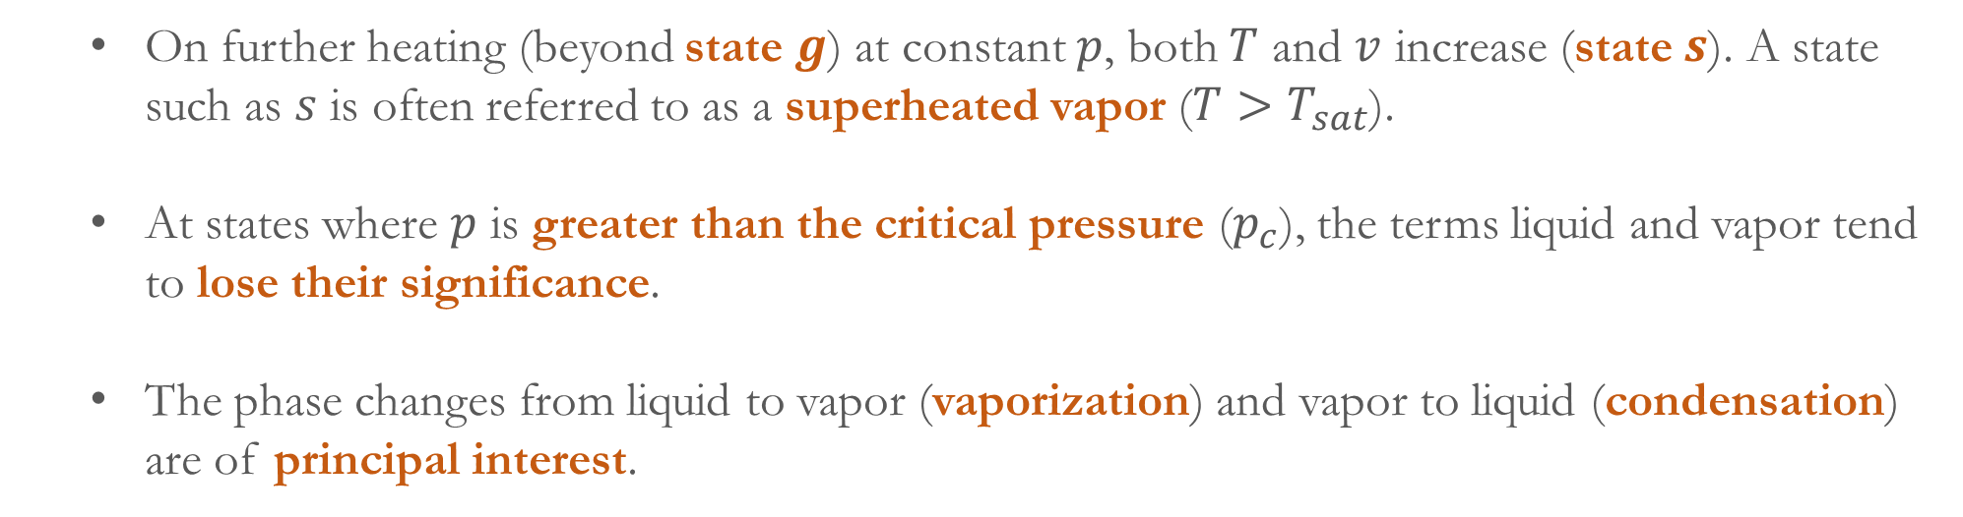
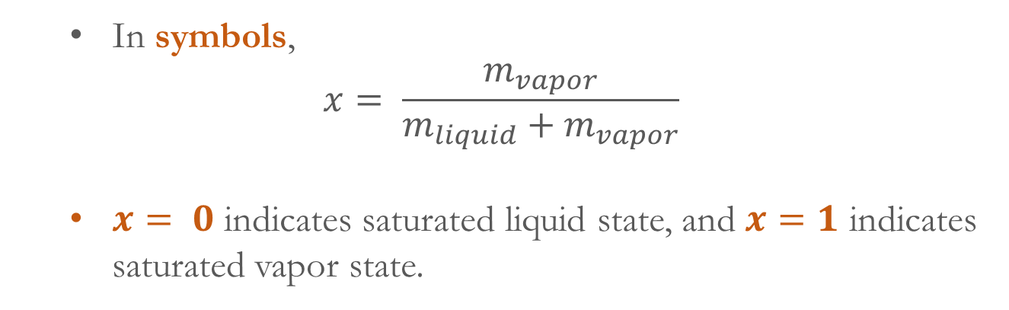
  In symbols,
$$x= \frac{m_{vapor}}{m_{liquid}+m_{vapor}}$$
$x= 0$ indicates saturated liquid state, and $x=1$ indicates saturated vapor state.
  On further heating (beyond state $g$) at constant $p$, both $T$ and $v$ increase (state $s$). A state such as $s$ is often referred to as a superheated vapor ($T>T_{sat}$).
  At states where $p$ is greater than the critical pressure ($p_{c}$), the terms liquid and vapor tend to lose their significance.
  The phase changes from liquid to vapor (vaporization) and vapor to liquid (condensation) are of principal interest.

Slide 5
  However, the phase changes from solid to liquid (melting) and from solid to vapor (sublimation) find their application in many practical systems.
  When a solid is heated, melting occurs with pressure greater than triple point pressure, whereas sublimation occurs when the pressure is less than triple point pressure.
  Thermodynamics property data can be found in tables which are commonly available for pure, simple compressible substances.
  Making use of these tables is an important skill. The tables for the properties of water are referred as steam tables. Tables are also available for different refrigerants, propane, etc.
  The properties of water vapor and liquid water are listed in superheated vapor tables (Table A4) and compressed liquid tables (Table A5), respectively.

Slide 6
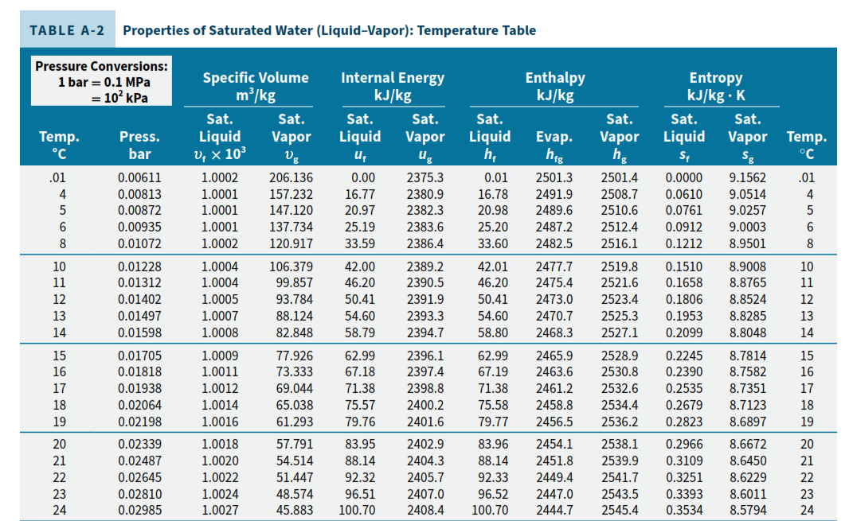

Slide 7
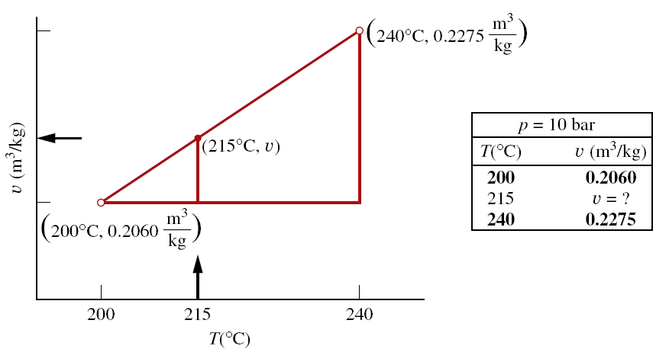
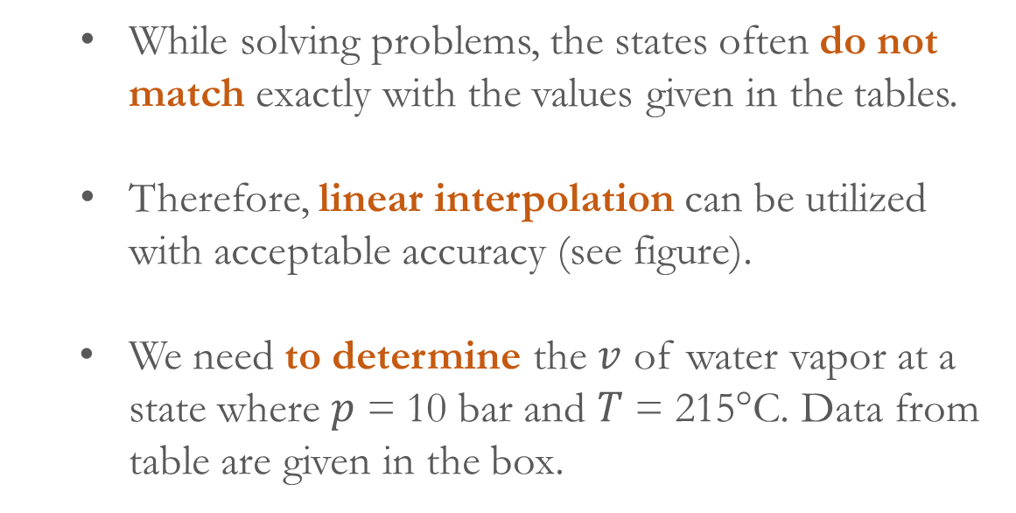
  In those tables, the values of several properties such as specific volume ($v$), specific internal energy ($u$), specific enthalpy ($h$) and specific entropy ($s$) are given as a function of $p$ and $T$.
While solving problems, the states often do not match exactly with the values given in the tables.
Therefore, linear interpolation can be utilized with acceptable accuracy (see figure).
We need to determine the $v$ of water vapor at a state where $p$ = 10 bar and $T$ = 215°C. Data from table are given in the box.
  Now, we can think of the slope of a straight line joining the adjacent table entries as

Slide 8
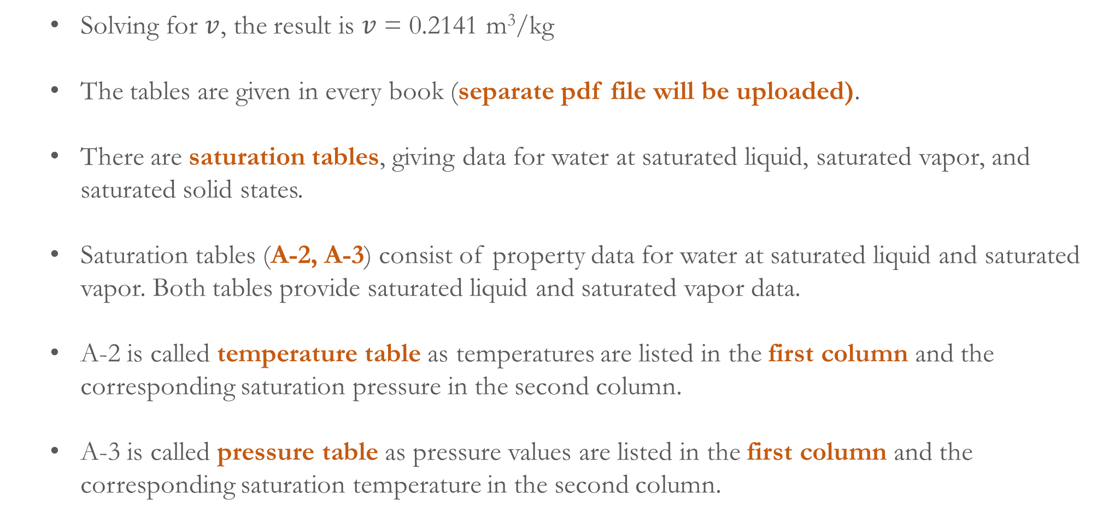
  Solving for $v$, the result is $v$ = 0.2141 m³/kg
  The tables are given in every book (separate pdf file will be uploaded).
  There are saturation tables, giving data for water at saturated liquid, saturated vapor, and saturated solid states.
  Saturation tables (A-2, A-3) consist of property data for water at saturated liquid and saturated vapor. Both tables provide saturated liquid and saturated vapor data.
  A-2 is called temperature table as temperatures are listed in the first column and the corresponding saturation pressure in the second column.
  A-3 is called pressure table as pressure values are listed in the first column and the corresponding saturation temperature in the second column.

Slide 10
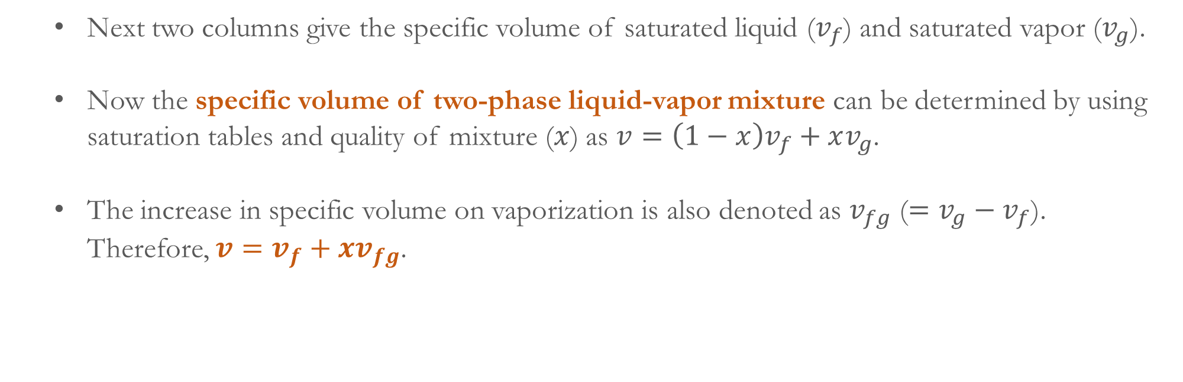
  Next two columns give the specific volume of saturated liquid ($v_{f}$) and saturated vapor ($v_{g}$).
  Now the specific volume of two-phase liquid-vapor mixture can be determined by using saturation tables and quality of mixture ($x$) as $v=\left(1−x\right)v_{f}+xv_{g}$.
  The increase in specific volume on vaporization is also denoted as $v_{fg}$ ($=v_{g}−v_{f}$). Therefore, $v=v_{f}+xv_{fg}$.

Slide 11
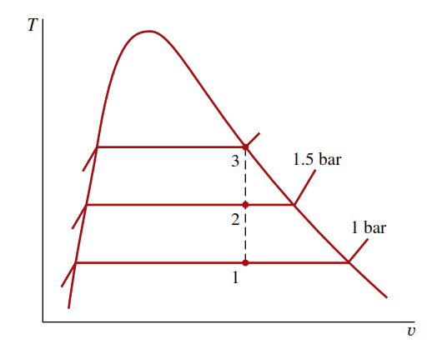
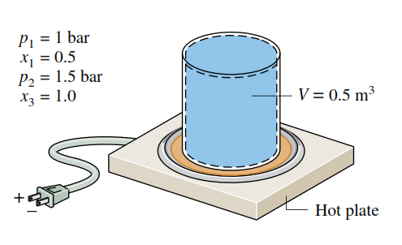
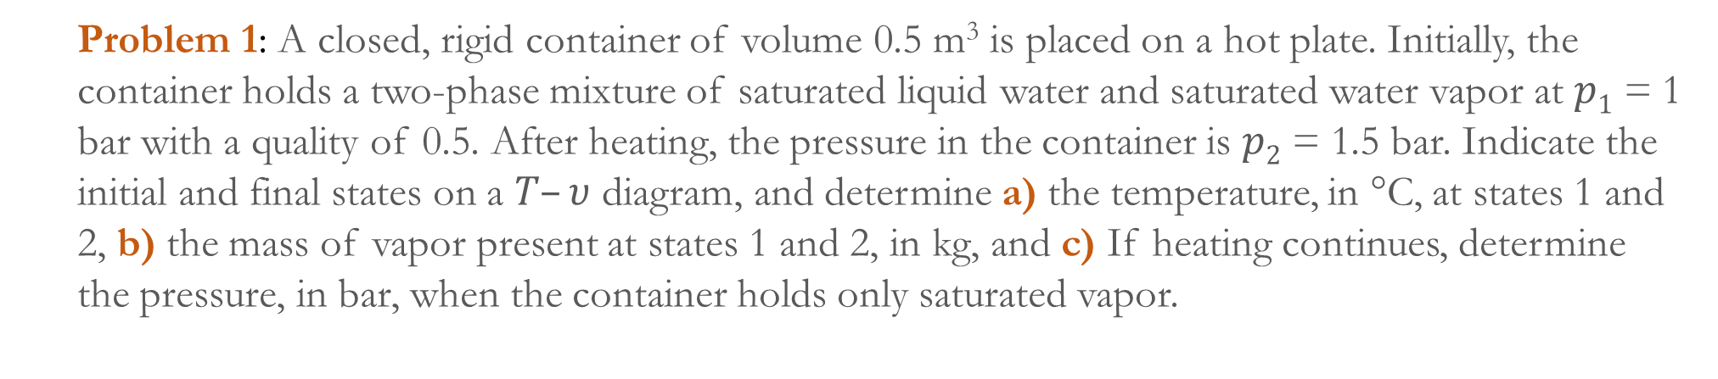
  Problem 1: A closed, rigid container of volume 0.5 m³ is placed on a hot plate. Initially, the container holds a two-phase mixture of saturated liquid water and saturated water vapor at $p1$ = 1 bar with a quality of 0.5. After heating, the pressure in the container is $p2$ = 1.5 bar. Indicate the initial and final states on a $T–υ$ diagram, and determine a) the temperature, in °C, at states 1 and 2, b) the mass of vapor present at states 1 and 2, in kg, and c) If heating continues, determine the pressure, in bar, when the container holds only saturated vapor.

Slide 12
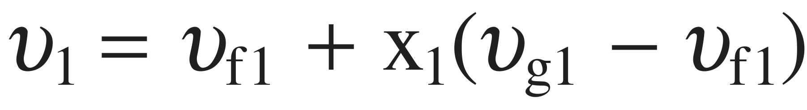
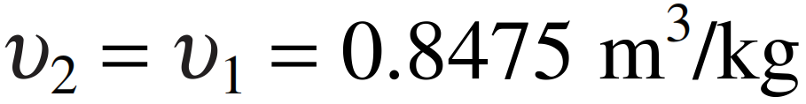
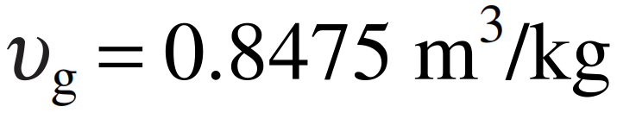
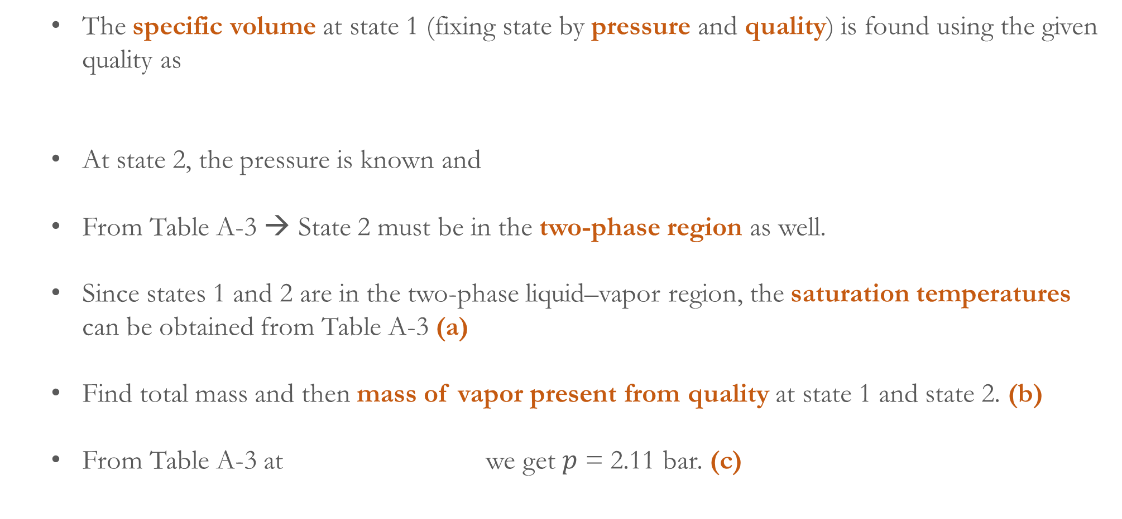
  The specific volume at state 1 (fixing state by pressure and quality) is found using the given quality as
  At state 2, the pressure is known and
  From Table A-3 → State 2 must be in the two-phase region as well.
  Since states 1 and 2 are in the two-phase liquid–vapor region, the saturation temperatures can be obtained from Table A-3 (a)
  Find total mass and then mass of vapor present from quality at state 1 and state 2. (b)
  From Table A-3 at we get $p$ = 2.11 bar. (c)

Slide 13
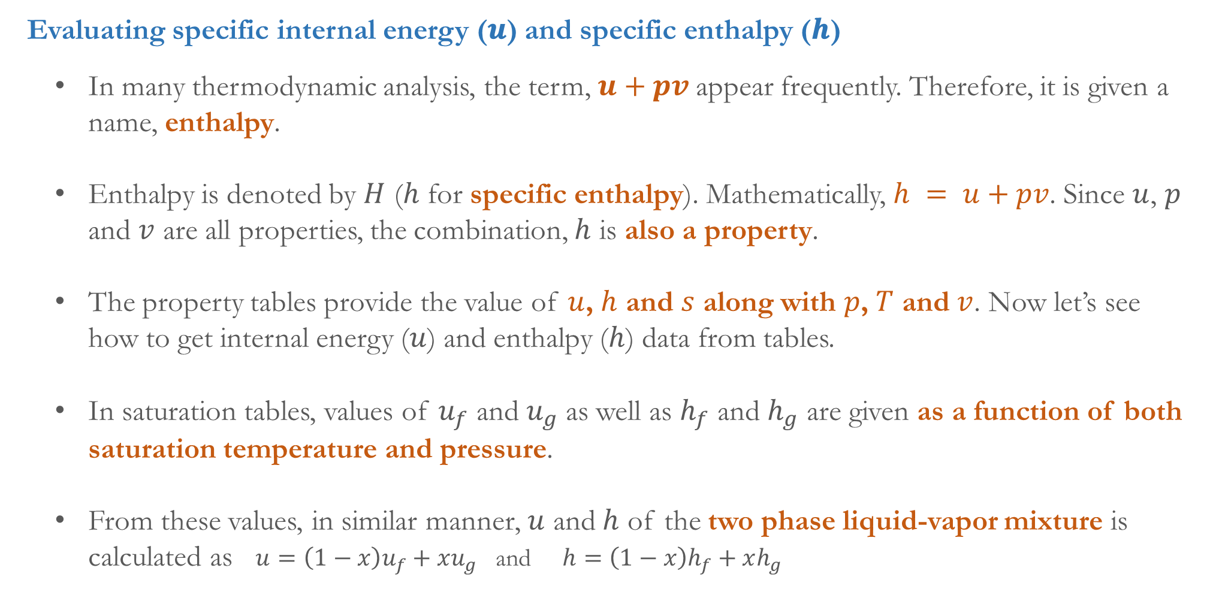
  Evaluating specific internal energy (𝒖) and specific enthalpy (𝒉)
  In many thermodynamic analysis, the term, $u+pv$appear frequently. Therefore, it is given a name, enthalpy.
  Enthalpy is denoted by $H$ ($h$ for specific enthalpy). Mathematically, $h = u+pv$. Since $u$, $p$ and $v$ are all properties, the combination, $h$ is also a property.
  The property tables provide the value of $u$, $h$ and $s$ along with $p$, $T$ and $v$. Now let’s see how to get internal energy ($u$) and enthalpy ($h$) data from tables.
  In saturation tables, values of $u_{f}$ and $u_{g}$ as well as $h_{f}$ and $h_{g}$ are given as a function of both saturation temperature and pressure.
  From these values, in similar manner, $u$ and $h$ of the two phase liquid-vapor mixture is calculated as $u=\left(1−x\right)u_{f}+xu_{g}$ and $h=\left(1−x\right)h_{f}+xh_{g}$

Slide 15
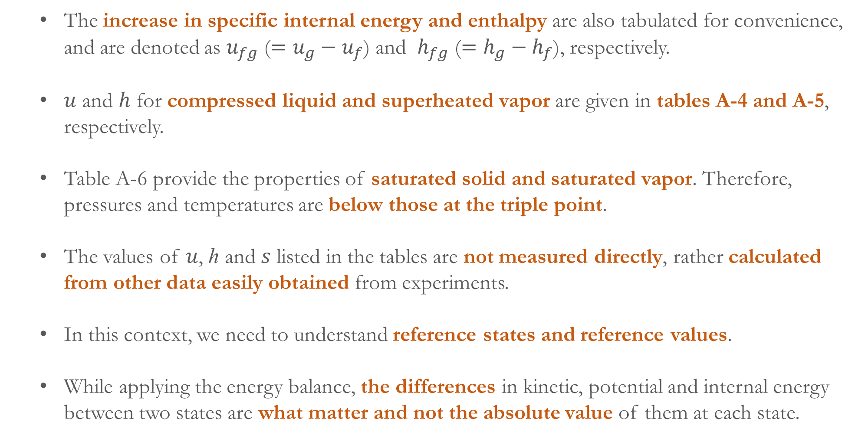
  The increase in specific internal energy and enthalpy are also tabulated for convenience, and are denoted as $u_{fg}$ ($=u_{g}−u_{f}$) and $h_{fg}$ ($=h_{g}−h_{f}$), respectively.
  $u$ and $h$ for compressed liquid and superheated vapor are given in tables A-4 and A-5, respectively.
  Table A-6 provide the properties of saturated solid and saturated vapor. Therefore, pressures and temperatures are below those at the triple point.
  The values of 𝑢, ℎ and 𝑠 listed in the tables are not measured directly, rather calculated from other data easily obtained from experiments.
  In this context, we need to understand reference states and reference values.
  While applying the energy balance, the differences in kinetic, potential and internal energy between two states are what matter and not the absolute value of them at each state.

Slide 16
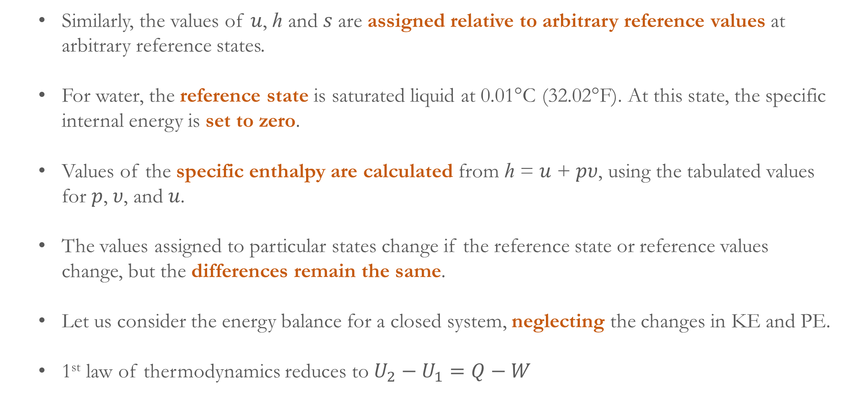
  Similarly, the values of 𝑢, ℎ and 𝑠 are assigned relative to arbitrary reference values at arbitrary reference states.
  For water, the reference state is saturated liquid at 0.01°C (32.02°F). At this state, the specific internal energy is set to zero.
  Values of the specific enthalpy are calculated from ℎ = 𝑢 + 𝑝𝜐, using the tabulated values for 𝑝, 𝜐, and 𝑢.
  The values assigned to particular states change if the reference state or reference values change, but the differences remain the same.
  Let us consider the energy balance for a closed system, neglecting the changes in KE and PE.
  1st law of thermodynamics reduces to $U_{2}−U_{1}=Q−W$

Slide 17
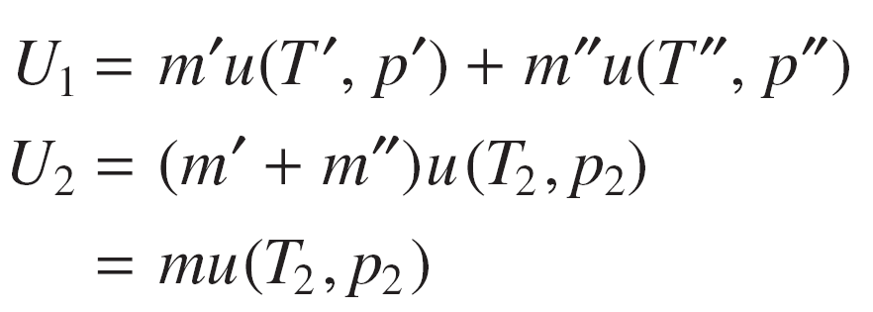
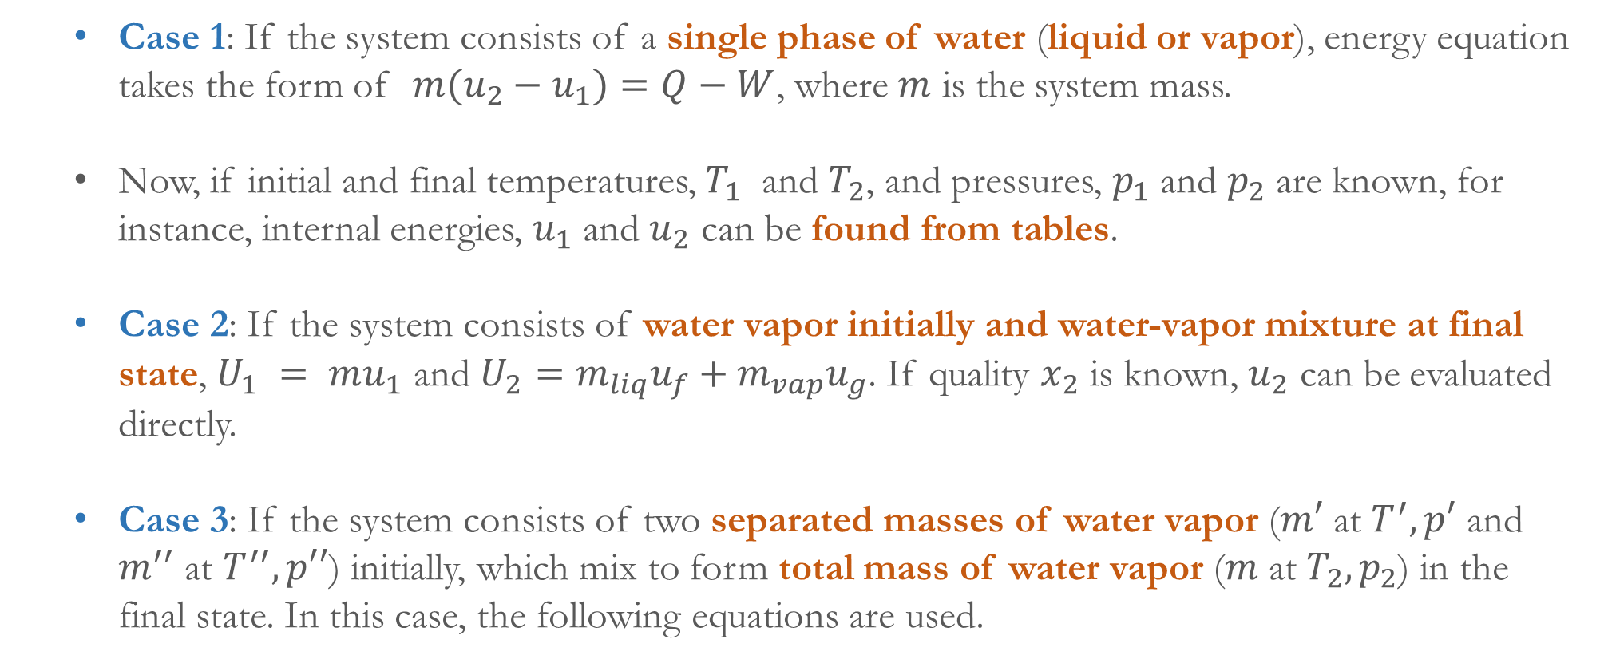
Case 1: If the system consists of a single phase of water (liquid or vapor), energy equation takes the form of ${m(u}_{2}−u_{1})=Q−W$, where $m$ is the system mass.
Now, if initial and final temperatures, $T_{1}$ and $T_{2}$, and pressures, $p_{1}$ and $p_{2}$ are known, for instance, internal energies, $u_{1}$ and $u_{2}$ can be found from tables.
Case 2: If the system consists of water vapor initially and water-vapor mixture at final state, $U_{1} = mu_{1}$ and $U_{2}=m_{liq}u_{f}+m_{vap}u_{g}$. If quality $x_{2}$ is known, $u_{2}$ can be evaluated directly.
Case 3: If the system consists of two separated masses of water vapor ($m′$ at $T^{′}, p′$ and $m^{′′}$ at $T^{′′},p′′$) initially, which mix to form total mass of water vapor ($m$ at $T_{2},p_{2}$) in the final state. In this case, the following equations are used.

Slide 18
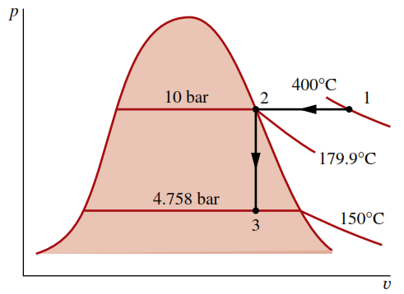
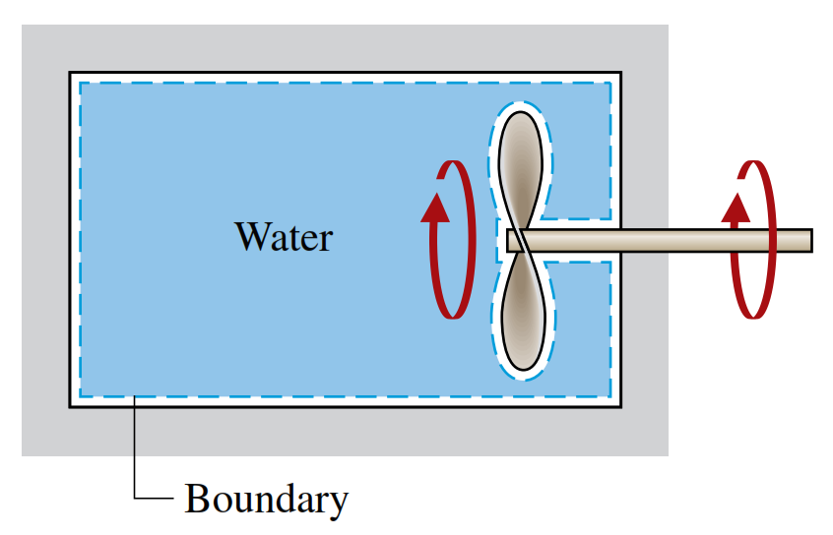
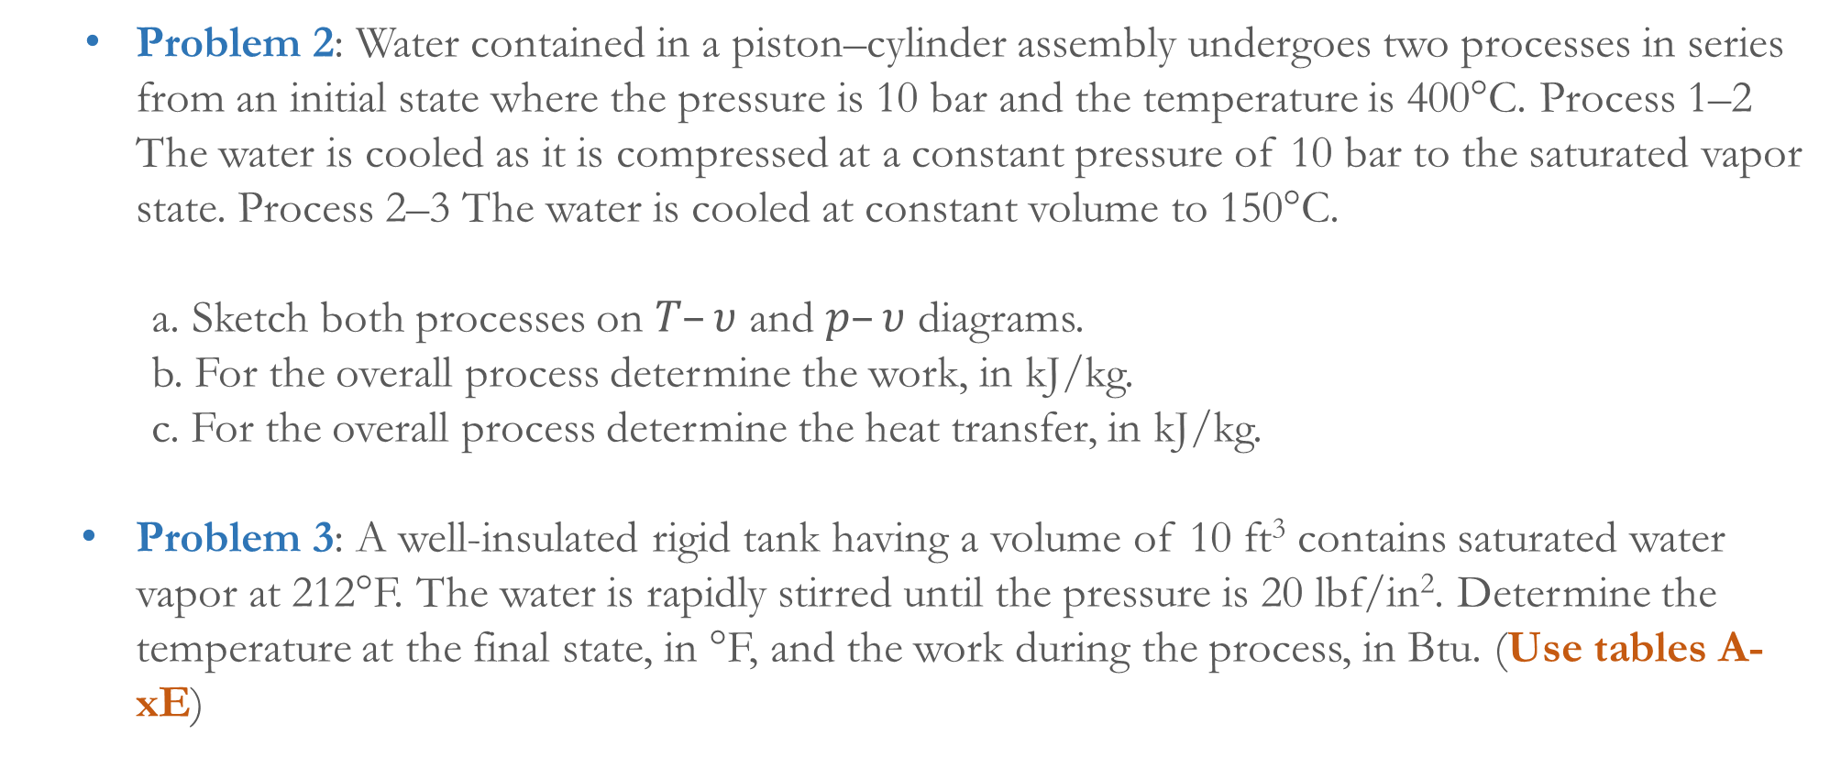
Problem 2: Water contained in a piston–cylinder assembly undergoes two processes in series from an initial state where the pressure is 10 bar and the temperature is 400°C. Process 1–2 The water is cooled as it is compressed at a constant pressure of 10 bar to the saturated vapor state. Process 2–3 The water is cooled at constant volume to 150°C.
a. Sketch both processes on $T–υ$ and $p–υ$ diagrams.
b. For the overall process determine the work, in kJ/kg.
c. For the overall process determine the heat transfer, in kJ/kg.
Problem 3: A well-insulated rigid tank having a volume of 10 ft³ contains saturated water vapor at 212°F. The water is rapidly stirred until the pressure is 20 lbf/in². Determine the temperature at the final state, in °F, and the work during the process, in Btu. (Use tables A-xE)

